Slide 1

University of Modena and Reggio Emilia Faculty of Engineering «Enzo Ferrari» Bachelor’s Degree in Computer Engineering Academic Year 2021/2022
SMART PLUG-TOP DIGITAL
Candidate: Ilyas Hamza
Student ID: 141933

Slide 2
Introduction to Internal Combustion Engines with Controlled Ignition process
Battery input of 14 Volt nominal tension;
Storage of Electrical energy in the Ignition Coil ;
High Voltage production induced by Ignition Coils;
Flow of tension controlled by opening-closing of the contac breaker (also known as «points»);
Distribution of High tension;
Generation of electric arc between the electrodes of Spark Plugs;
Ignition of the air-fuel mixture.

Slide 3
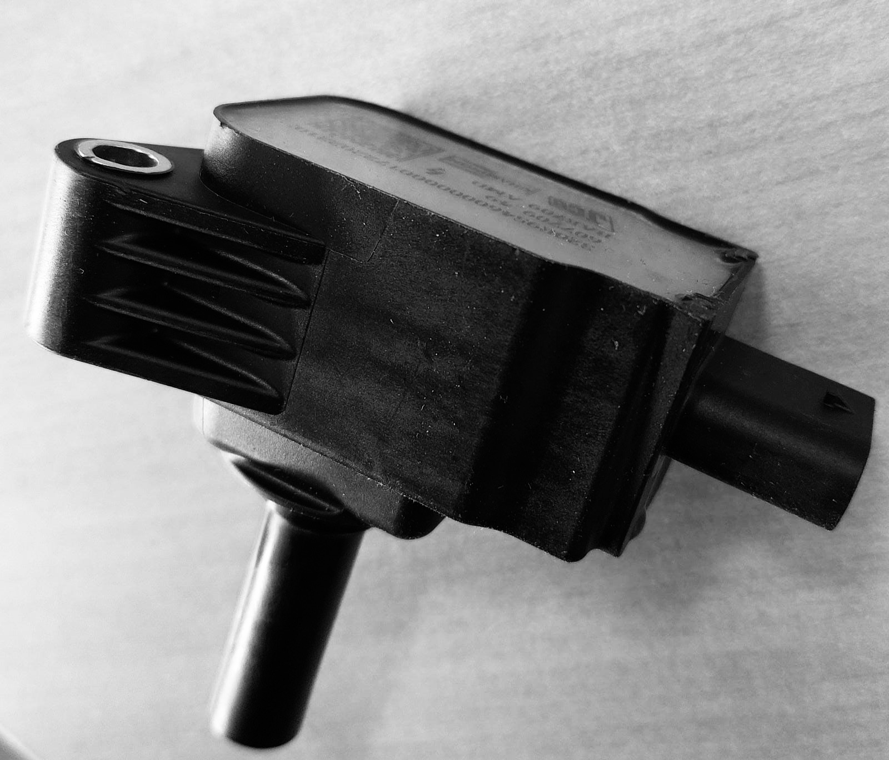
Ignition coil
The Ignition Coil is generally composed of two Coils, primary and secondary and a Transformer.
Its goal is to store energy from the primary winding, and then discharge it onto the secondary winding, thus generating a high tension up to 50 kV.

Slide 4
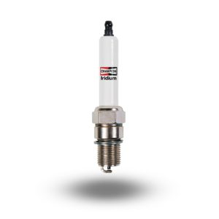
Spark Plug
The Spark Plug, as the name suggests, is responsible for the spark that starts the process of Combustion.
High Voltage tension coming from the Ignition coil enables the generation of an electrical arc between the two electrodes in it.

Slide 5
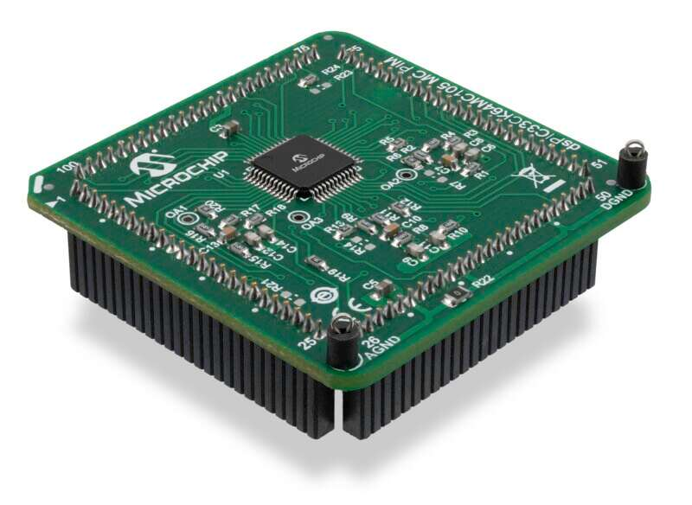
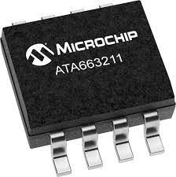
Sptd
The purpose of the SPTD is to introduce advanced diagnostical capabilities, that will allow a real-time diagnoses of the main ignition components.
Project requirements:
The Microcontroller environment (dsPIC33).
Use the necessary modules.
Correctly interpret the various I/O signals (Ignition signals).
Communicate with external devices (ECU) through LIN protocol.

Slide 6

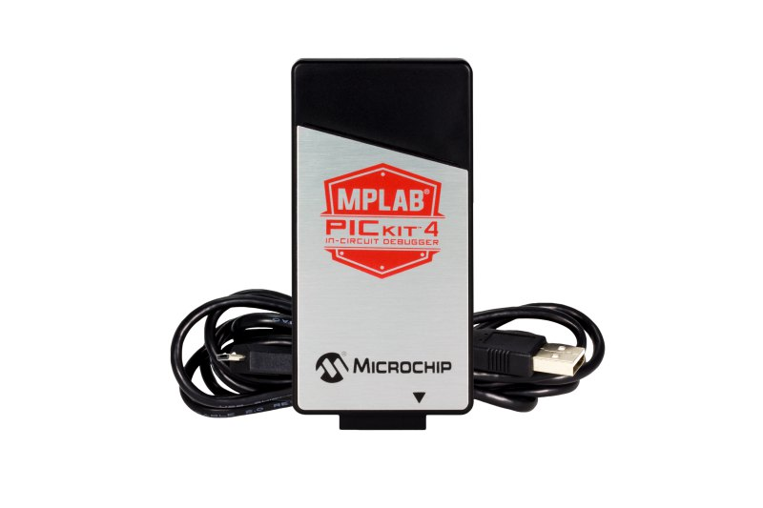
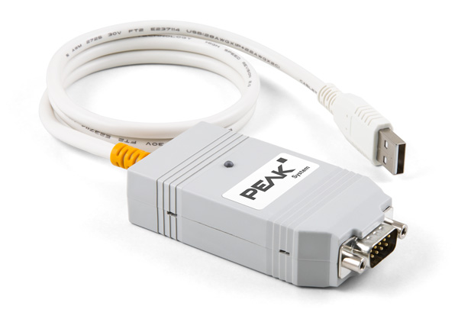
Firmware Environment & TOOLS
MPLAB X IDE.
MCC, automated code generation tool.
Programming language is C.
XC16 C compiler (16-bit).
PICkit™ On-Board (PKOB4) for Programming and Debugging.
Peak systems PLIN-USB for testing.

Slide 7
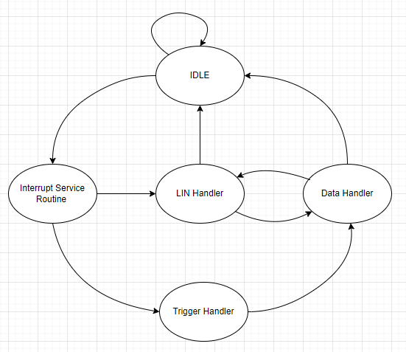
Firmware architecture
The developed firmware follows an interrupt-driven architecture.
The Modular code structure allowed independent development and testing of the following modules:
Trigger Handler;
Data Handler;
LIN Handler;
FSM diagram realized with draw.io

Slide 8
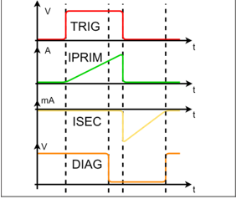
trigger handler
This Handler is responsible for correctly interpreting the I/O signals of the Ignition circuitry (slide 5).
Trigger interrupt starts the 1° phase of data collection.
When a certain Threshold is reached (Captured & Compared) with the SCCP module, 1° phase ends.
The 2° phase starts with the opening of the circuit.
2° phase ends when all the accumulated energy is dissipated.

Slide 9
Data handler
Manages, verifies and stores the data received from the Interrupt handler.
Contains the main algorithm to verify data reliability depending on signal values.
Depending on the engines working conditions, generates further diagnostical data about its state and lifecycle.
Stores data in registers accessible to LIN Handler.

Slide 10
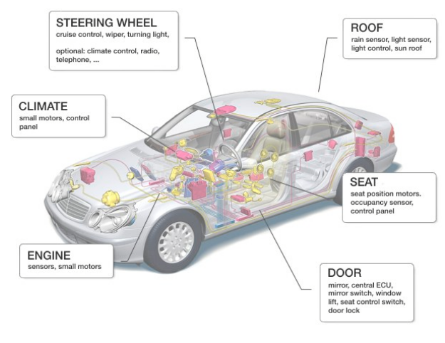
LIN (iso17987-1-2016)
Low speed, with a maximum of 20 kbits/s.
Cost-effective solution alternative to CAN bus systems.
Uses a single 12 Volt Wire.
Unidirectional Master-Slaves communication.
Reliable communication, with error detection and correction mechanisms.

Slide 11
LIN handler
Peak systems PLIN-USB hardware
Handles all the communication of the SPTD with external world.
Implemented as a LIN Slave.
Allows testing of SPTD capabilities, using host PC as master.
Enables software programming and testing of the firmware through PLIN-USB, as hardware resource, and PLIN API, as software interface.

Slide 12
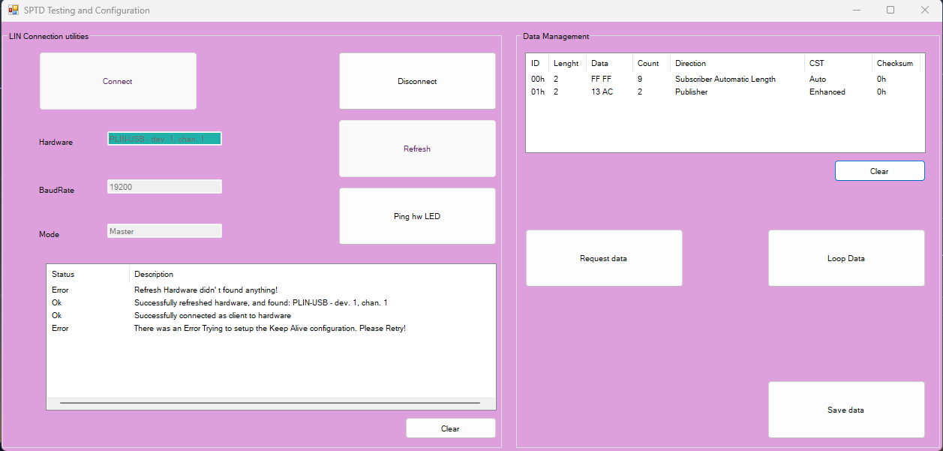
Testing and parameterization software
Registers and
Unregister host
PC as LIN Master
ListView of requested LIN frames
Refresh the List
of hardware
resources
Clear ListView
Toggle Red/green
Led of PLI-USB
Polling data requests
until disconnected
ListView of actions
on the LIN BUS
Save received LIN
Data as .txt file
Clear ListView
One shot LIN
Data request

Slide 13
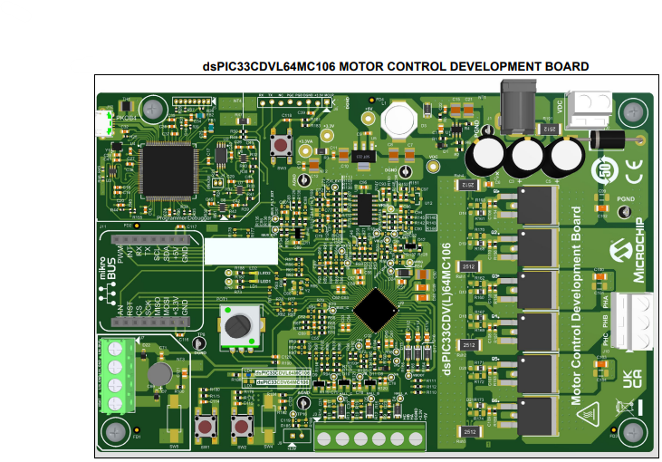
Thank YOU
FOR ATTENDING!
taking this opportunity to express my deepest gratitude to my esteemed mentor, engineer Simone Daniele.

